Slide 1
Covariance and Dependence
An application to portfolio allocation

Slide 2
Canonical Correlation Analysis

Slide 3

What is “Canonical” Correlation Analysis?
A method for measuring the correlation among 2 sets of variables
Maximize correlation between two sets of variables
Variables might not have dependent-independent variable relationship
Example: correlation between exercise and health. 2 sets, each with multiple variables.
Set 1: Exercise ~ Running speed, push-ups per minute, weight lifting, etc.
Set 2: Health ~ Body mass index, blood pressure, heart rate, etc.
Useful when number of dimensions in dataset is large
Similar to PCA
PCA maximizes variance
CCA maximizes correlation
Both use singular value decomposition to find results

Slide 4
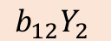
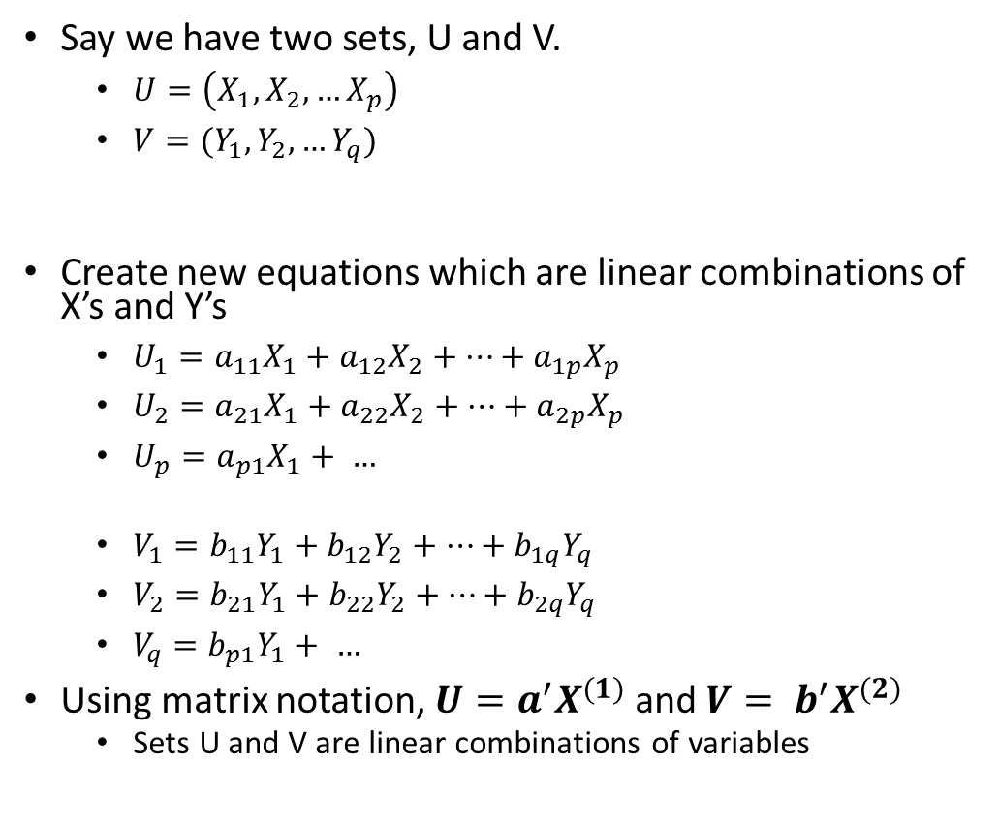
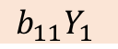
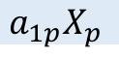
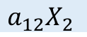
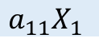
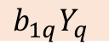
2 Sets of Variables
Set U
Say we have two sets, U and V.
$U=\left(X_{1}, X_{2}, …X_{p}\right)$
$V=(Y_{1}, Y_{2}, …Y_{q})$
Create new equations which are linear combinations of X’s and Y’s
$U_{1}=a_{11}X_{1}+a_{12}X_{2}+…+a_{1p}X_{p}$
$U_{2}=a_{21}X_{1}+a_{22}X_{2}+…+a_{2p}X_{p}$
$U_{p}=a_{p1}X_{1}+ …$
$V_{1}=b_{11}Y_{1}+b_{12}Y_{2}+…+b_{1q}Y_{q}$
$V_{2}=b_{21}Y_{1}+b_{22}Y_{2}+…+b_{2q}Y_{q}$
$V_{q}=b_{p1}Y_{1}+ …$
Using matrix notation, $U=a^{′}X^{(1)}$ and ${V= b}^{′}X^{(2)}$
Sets U and V are linear combinations of variables
Canonical Correlation
$$a_{11}X_{1}$$
Set V
$$a_{12}X_{2}$$
Variables
.
$$b_{11}Y_{1}$$
.
$$b_{12}Y_{2}$$
.
.
.
.
.
.
$$b_{1q}Y_{q}$$
Coefficients
.
.
$$a_{1p}X_{p}$$

Slide 5
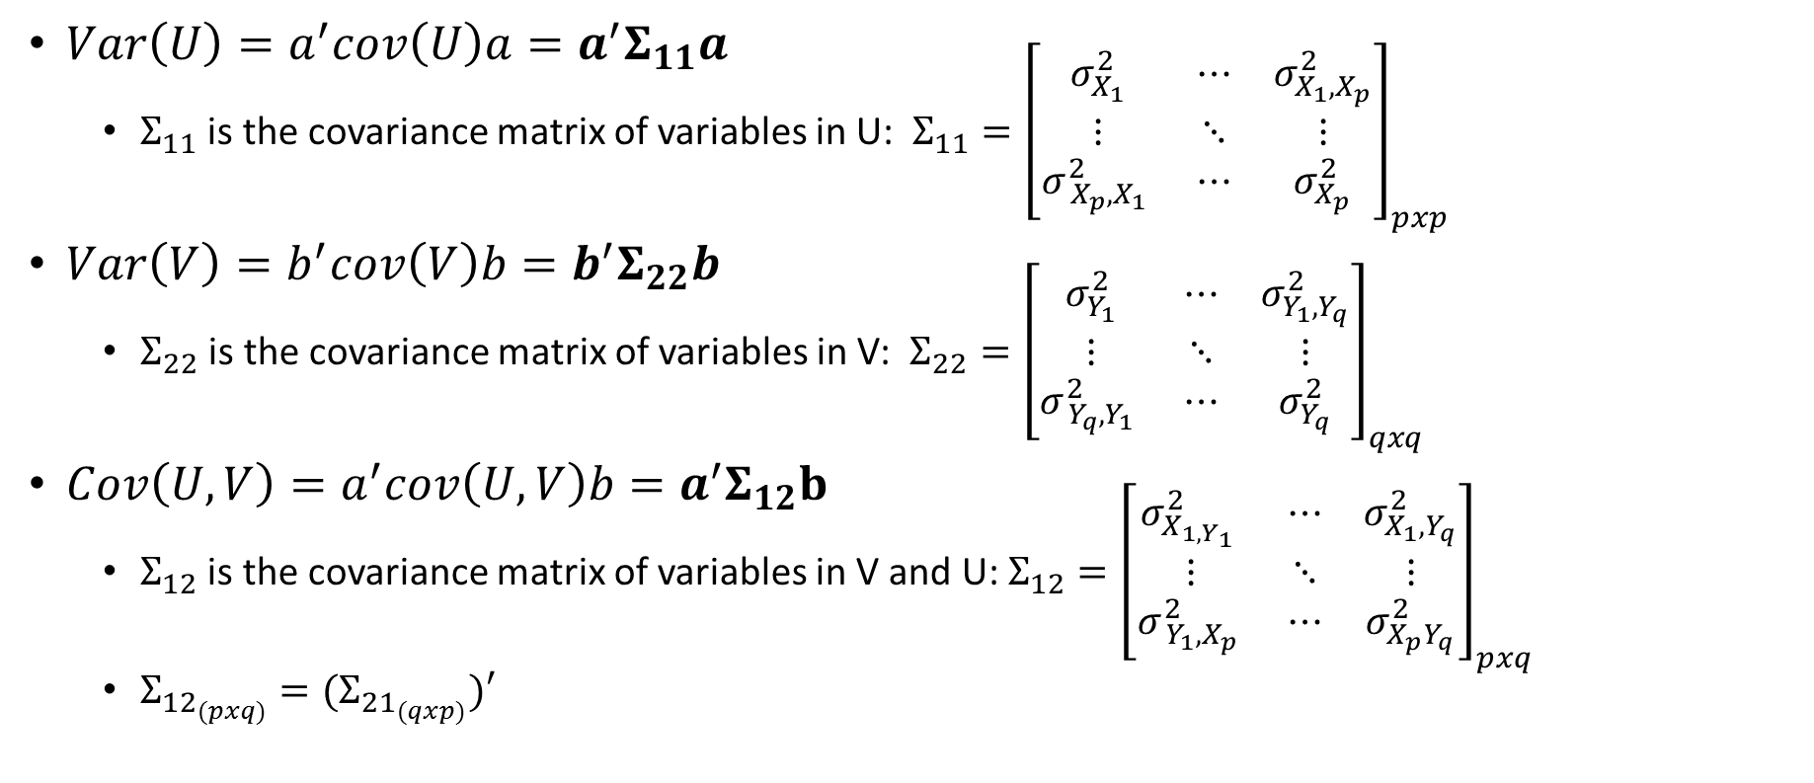
Defining Variance and Covariance of Sets
$Var\left(U\right)=a^{′}cov\left(U\right)a=a^{′}Σ_{11}a$
$Σ_{11}$ is the covariance matrix of variables in U: $Σ_{11}={\left[\begin{matrix}σ_{X_{1}}^{2} & ⋯ & σ_{X_{1},X_{p}}^{2} \\ ⋮ & ⋱ & ⋮ \\ σ_{ X_{p},X_{1} }^{2} & ⋯ & σ_{X_{p}}^{2}\end{matrix}\right]}_{pxp}$
$Var\left(V\right)=b^{′}cov\left(V\right)b=b^{′}Σ_{22}b$
$Σ_{22}$ is the covariance matrix of variables in V: $Σ_{22}={\left[\begin{matrix}σ_{Y_{1}}^{2} & ⋯ & σ_{Y_{1},Y_{q}}^{2} \\ ⋮ & ⋱ & ⋮ \\ σ_{ Y_{q},Y_{1} }^{2} & ⋯ & σ_{Y_{q}}^{2}\end{matrix}\right]}_{qxq}$
$Cov\left(U,V\right)=a^{′}cov\left(U,V\right)b=a^{′}Σ_{12}b$
$Σ_{12}$ is the covariance matrix of variables in V and U: $Σ_{12}={\left[\begin{matrix}σ_{X_{1,Y_{1} }}^{2} & ⋯ & σ_{X_{1},Y_{q}}^{2} \\ ⋮ & ⋱ & ⋮ \\ σ_{ Y_{1},X_{p} }^{2} & ⋯ & σ_{X_{p}Y_{q}}^{2}\end{matrix}\right]}_{pxq}$
$Σ_{{12}_{(pxq)}}={(Σ}_{{21}_{(qxp)}})′$

Slide 6
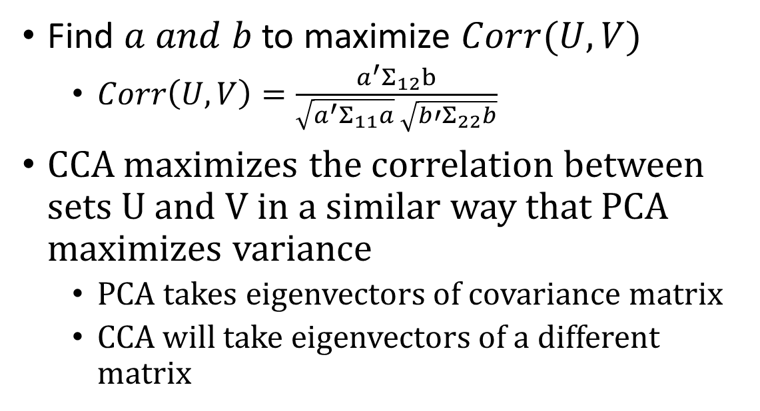
Maximizing Correlation
Goal: Find coefficients (a and b) that maximize correlation between sets, $U_{i}$ and $V_{i}$
Find $a and b$ to maximize $Corr(U,V)$
$Corr\left(U,V\right)=\frac{a^{′}Σ_{12}b}{\sqrt{a^{′}Σ_{11}a} \sqrt{b{′Σ}_{22}b}}$
CCA maximizes the correlation between sets U and V in a similar way that PCA maximizes variance
PCA takes eigenvectors of covariance matrix
CCA will take eigenvectors of a different matrix

Slide 7

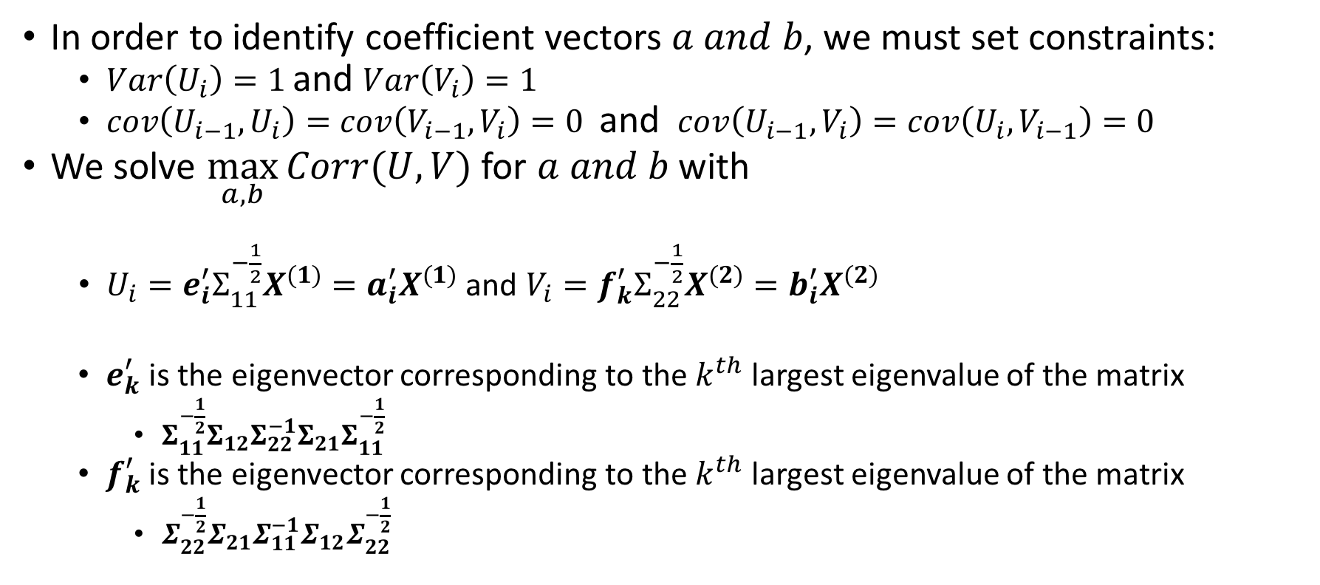

Implementation and Algorithm
In order to identify coefficient vectors $a and b$, we must set constraints:
$Var\left(U_{i}\right)=1$ and $Var\left(V_{i}\right)=1$
$cov\left(U_{i−1}, U_{i}\right)=cov\left(V_{i−1},V_{i}\right)=0$ and $cov\left(U_{i−1}, V_{i}\right)=cov\left(U_{i},V_{i−1}\right)=0$
We solve $\max_{a,b}{Corr(U,V)}$ for $a and b$ with
$U_{i}=e_{i}^{′}Σ_{11}^{−\frac{1}{2}}X^{(1)}=a_{i}^{′}X^{(1)}$ and $V_{i}=f_{k}^{′}Σ_{22}^{−\frac{1}{2}}X^{(2)}=b_{i}^{′}X^{(2)}$
$e_{k}^{′}$ is the eigenvector corresponding to the $k^{th}$ largest eigenvalue of the matrix
$Σ_{11}^{−\frac{1}{2}}Σ_{12}Σ_{22}^{−1}Σ_{21}Σ_{11}^{−\frac{1}{2}}$
$f_{k}^{′}$ is the eigenvector corresponding to the $k^{th}$ largest eigenvalue of the matrix
$Σ_{22}^{−\frac{1}{2}}Σ_{21}Σ_{11}^{−1}Σ_{12}Σ_{22}^{−\frac{1}{2}}$
$$a_{i}^{′}$$
$$b_{i}^{′}$$

Slide 8
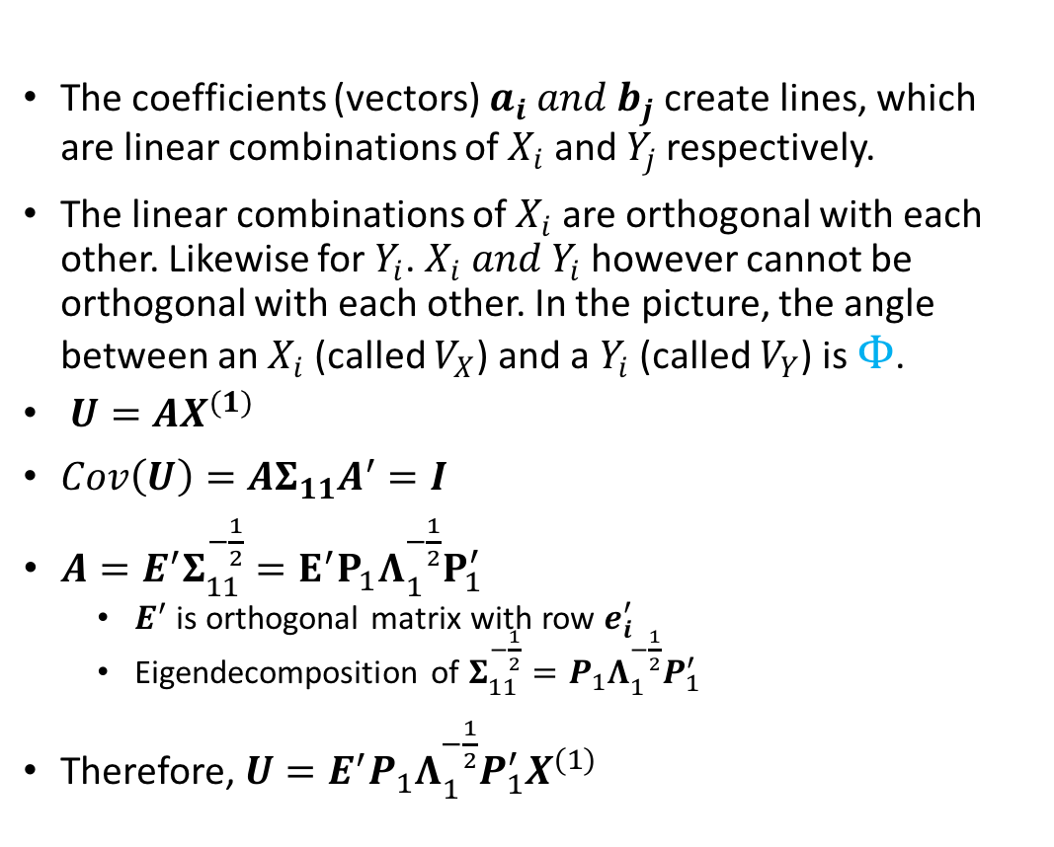
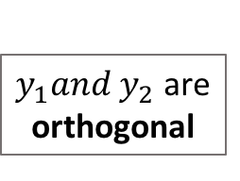
Interpretation and Intuition (I)
The coefficients (vectors) $a_{i} and b_{j}$ create lines, which are linear combinations of $X_{i}$ and $Y_{j}$ respectively.
The linear combinations of $X_{i}$ are orthogonal with each other. Likewise for $Y_{i}$. $X_{i} and Y_{i}$ however cannot be orthogonal with each other. In the picture, the angle between an $X_{i}$ (called $V_{X}$) and a $Y_{i}$ (called $V_{Y}$) is $Φ$.
$U=AX^{(1)}$
$Cov\left(U\right)=AΣ_{11}A^{′}=I$
$A=E^{′}Σ_{11}^{−\frac{1}{2}}=E^{′}P_{1}Λ_{1}^{−\frac{1}{2}}P_{1}^{′}$
$E^{′}$ is orthogonal matrix with row $e_{i}^{′}$
Eigendecomposition of $Σ_{11}^{−\frac{1}{2}}=P_{1}Λ_{1}^{−\frac{1}{2}}P_{1}^{′}$
Therefore, $U=E^{′}P_{1}Λ_{1}^{−\frac{1}{2}}P_{1}^{′}X^{(1)}$
U
V
$y_{1}and y_{2}$ are orthogonal

Slide 9
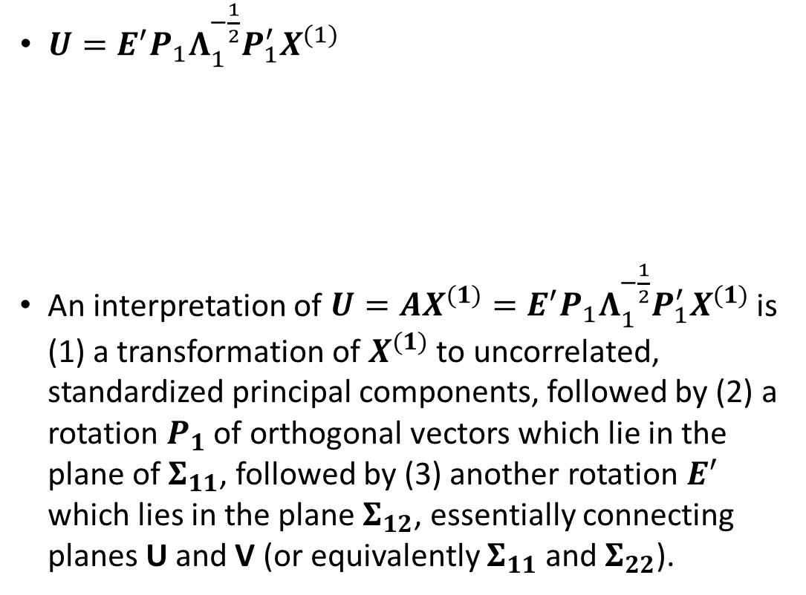
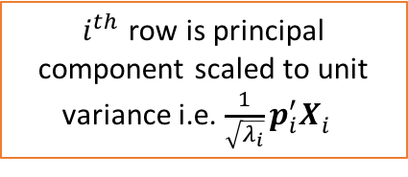
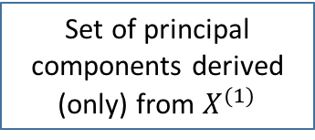
Interpretation and Intuition (II)
Canonical Correlation between 2 sets, U and V
Set of principal components derived (only) from $X^{(1)}$
$U=E^{′}P_{1}Λ_{1}^{−\frac{1}{2}}P_{1}^{′}X^{(1)}$
An interpretation of $U=AX^{(1)}=E^{′}P_{1}Λ_{1}^{−\frac{1}{2}}P_{1}^{′}X^{(1)}$ is (1) a transformation of $X^{(1)}$ to uncorrelated, standardized principal components, followed by (2) a rotation $P_{1}$ of orthogonal vectors which lie in the plane of $Σ_{11}$, followed by (3) another rotation $E^{′}$ which lies in the plane $Σ_{12}$, essentially connecting planes U and V (or equivalently $Σ_{11}$ and $Σ_{22}$).
$i^{th}$ row is principal component scaled to unit variance i.e. $\frac{1}{\sqrt{λ_{i}}}p_{i}^{′}X_{i}^{}$
U
V
$y_{1}and y_{2}$ are orthogonal

Slide 10
CCA Example

Slide 11
Data – Survey on Mental Health at Tech Co.
The data comes from a survey on mental health given to employees at a technology companies
We divide the data into two sets, namely sets of questions
SET 1 is on company policies towards mental health
SET 2 is how open employees are to talk about mental health
Questions from Policies on Mental Health (SET 1)
Does your employer provide mental health benefits?
Do you know the options for mental health care your employer provides?
Has your employer ever discussed mental health as part of an employee wellness program?
Does your employer provide resources to learn more about mental health issues and how to seek help?
Is your anonymity protected if you choose to take advantage of mental health or substance abuse treatment resources?
How easy is it for you to take medical leave for a mental health condition?
Questions from Openness about Mental Health (SET 2)
Do you think that discussing a mental health issue with your employer would have negative consequences?
Do you think that discussing a physical health issue with your employer would have negative consequences?
Would you be willing to discuss a mental health issue with your coworkers?
Would you be willing to discuss a mental health issue with your direct supervisor(s)?
Would you bring up a mental health issue with a potential employer in an interview?
Would you bring up a physical health issue with a potential employer in an interview?
Do you feel that your employer takes mental health as seriously as physical health?
Have you heard of or observed negative consequences for coworkers with mental health conditions in your workplace?

Slide 12
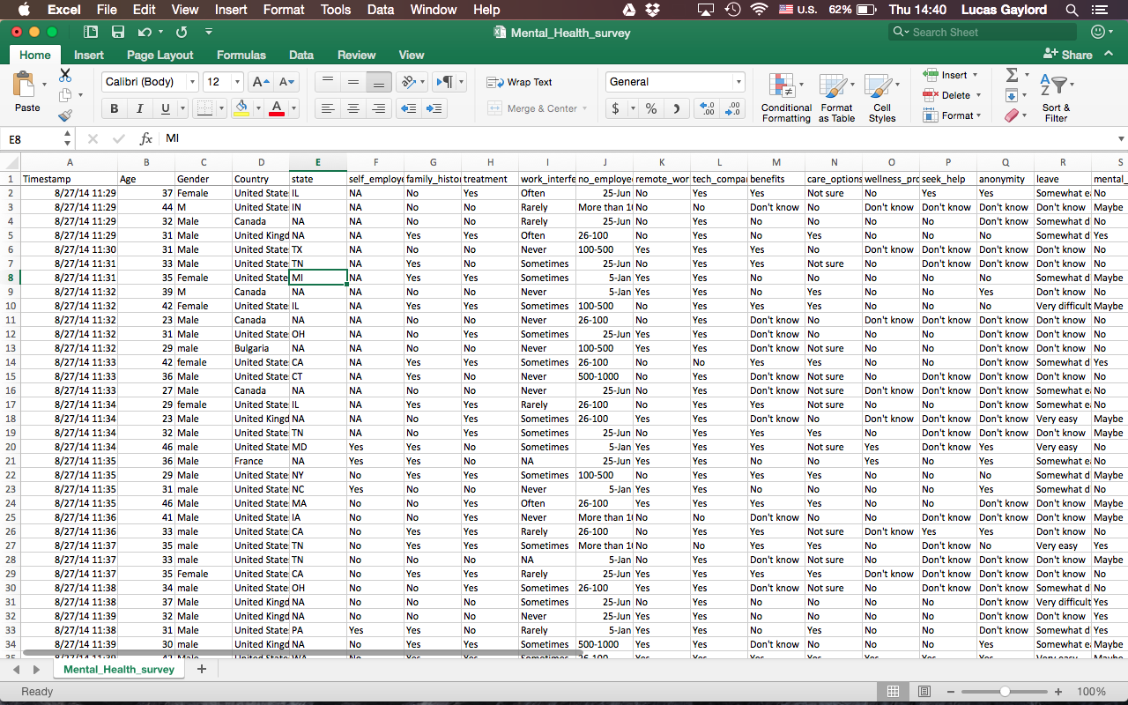
This is what the data looks like
Survey questions
Responses, aka “observations”

Slide 13
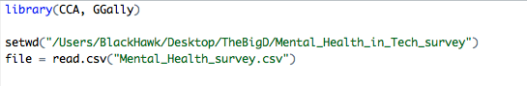
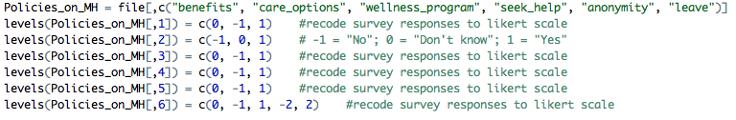
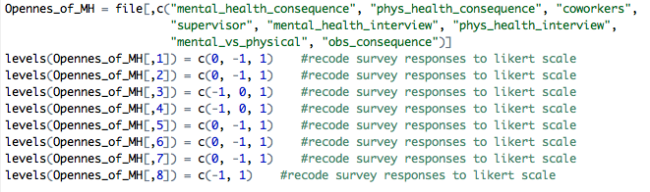
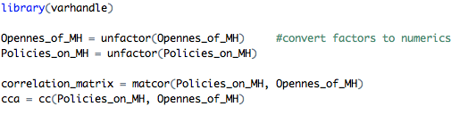
Code
Can simply use R package “CCA”
Recode survey responses to Likert Scale. This is the “lazy way” of doing it. In more important applications, code each variable response as 1 or 0
Calculate CCA

Slide 14
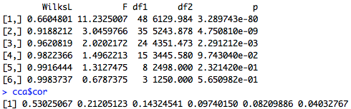
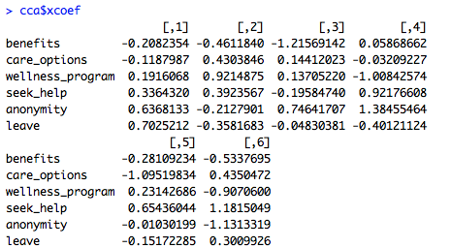
Results

Slide 15
Covariance Matrix Estimation

Slide 16
Covariance Matrix – 2 Potential Problems
When the data is sparse or has few observations we must estimate the covariance matrix.
A sample covariance matrix is created simply by taking the covariance matrix of raw sample data
2 potential problems:
Dimensionality – When there are more variables (columns) than observations (rows). A related problem is when there are few observations (not enough data).
Sparsity - When many variables are not actually correlated. There will be many 0s in the covariance matrix if this is the case.
Sparsity does not imply missing data. Only low correlations.
In these cases the sample covariance matrix is not positive definite, and therefore not an accurate representation of “true” covariance matrix

Slide 17
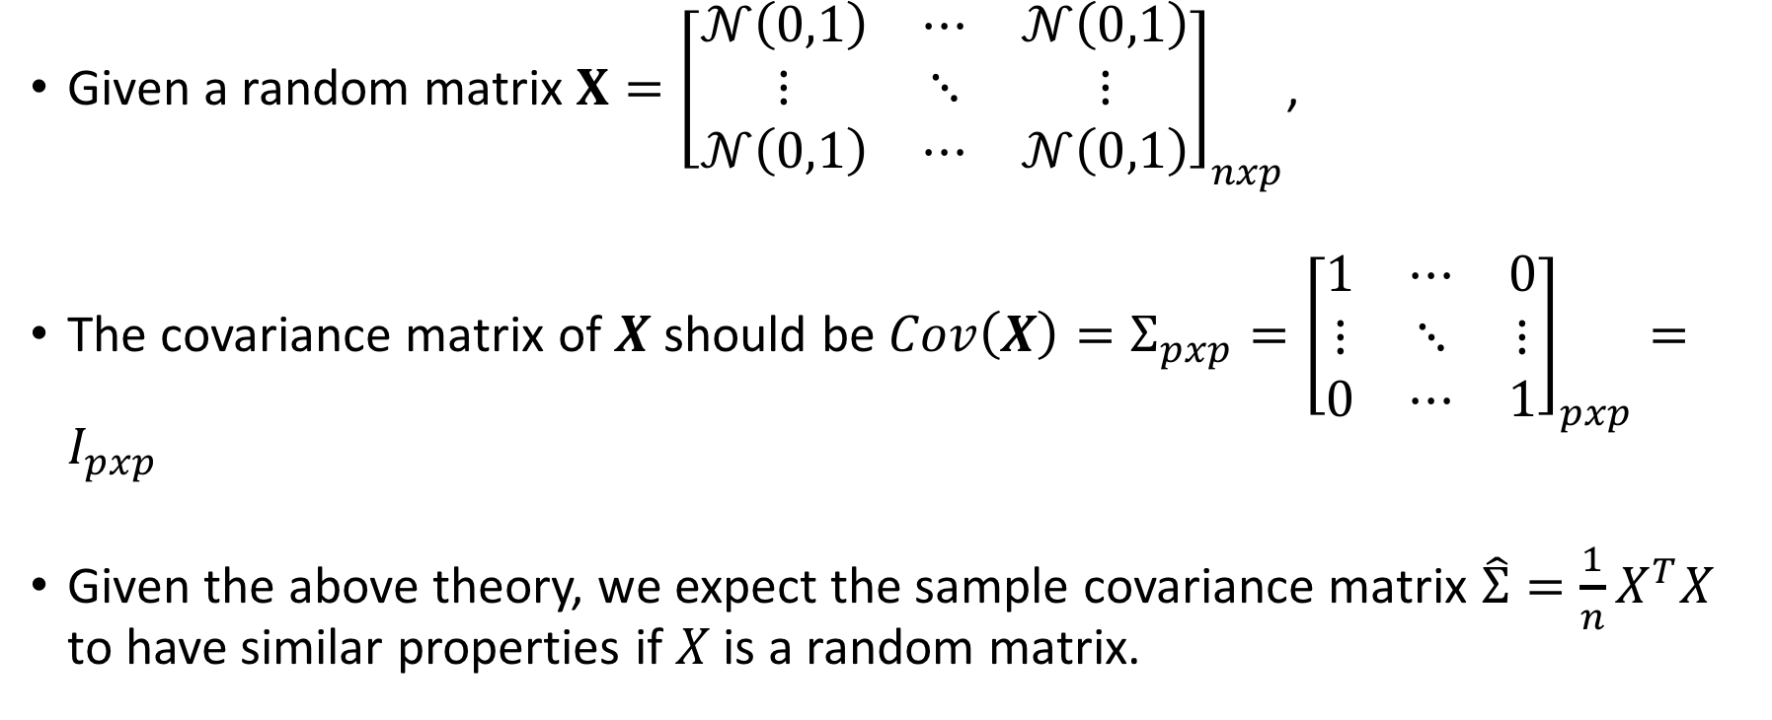
Eigenvalues of Covariance Matrix Theory
Given a random matrix $X={\left[\begin{matrix}𝒩\left(0,1\right) & ⋯ & 𝒩\left(0,1\right) \\ ⋮ & ⋱ & ⋮ \\ 𝒩\left(0,1\right) & ⋯ & 𝒩\left(0,1\right)\end{matrix}\right]}_{nxp}$,
The covariance matrix of $X$ should be $Cov\left(X\right)=Σ_{pxp}={\left[\begin{matrix}1 & ⋯ & 0 \\ ⋮ & ⋱ & ⋮ \\ 0 & ⋯ & 1\end{matrix}\right]}_{pxp}=I_{pxp}$
Given the above theory, we expect the sample covariance matrix $\hat{Σ}=\frac{1}{n}X^{T}X$ to have similar properties if $X$ is a random matrix.

Slide 18
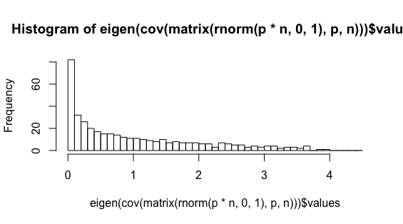
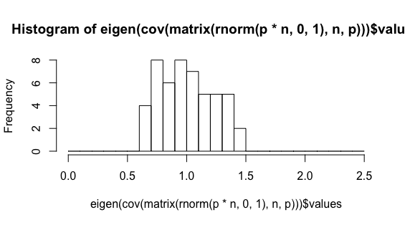
Eigenvalues of Covariance Matrix Application
If $n≤p$, the sample covariance matrix is not useful. We must improve it.
Distribution of eigenvalues does not follow theory when n is close to p
When n is much less than p, distribution is as expected
Eigenvalue
Eigenvalue
n = 400, p = 400
n = 50, p = 1000

Slide 19

Estimating the Covariance Matrix
An estimated covariance matrix is useful when the sample matrix is not an accurate representation of the ‘true’ covariance matrix
3 basic methods for estimating covariance matrix. Depends on structure of data
Structure - if … use …
Variables (columns) are ordered, such as time-series
Banding
Tappering
There does not appear to be an order or pattern in the data, but data is sparse
3. Thresholding

Slide 20
Banding

Slide 21
Banding Intuition
In data where the order matters (ex. time series) the correlations are influenced by the order of the variables
Variables ordered close together tend to have high correlations
Variables ordered further apart tend to have low correlation
For example, there will be a higher correlation in the temperatures in January and February than January and June.
This means values along the diagonal of the covariance matrix should be more significant than values that deviate from the diagonal

Slide 22
Banding Method
For example, values in this corners, out side the light colored band will go to 0.
In reality, when we take samples, we will get small correlations between variables that are not actually correlated.
The idea with banding is to find a a symmetric distance from the diagonal of the covariance matrix that contains all the most important values.
Then, we take all values not within that distance from the diagonal (outside the band) and set them to 0.
For example, values in this corners, out side the light colored band are set to 0.

Slide 23
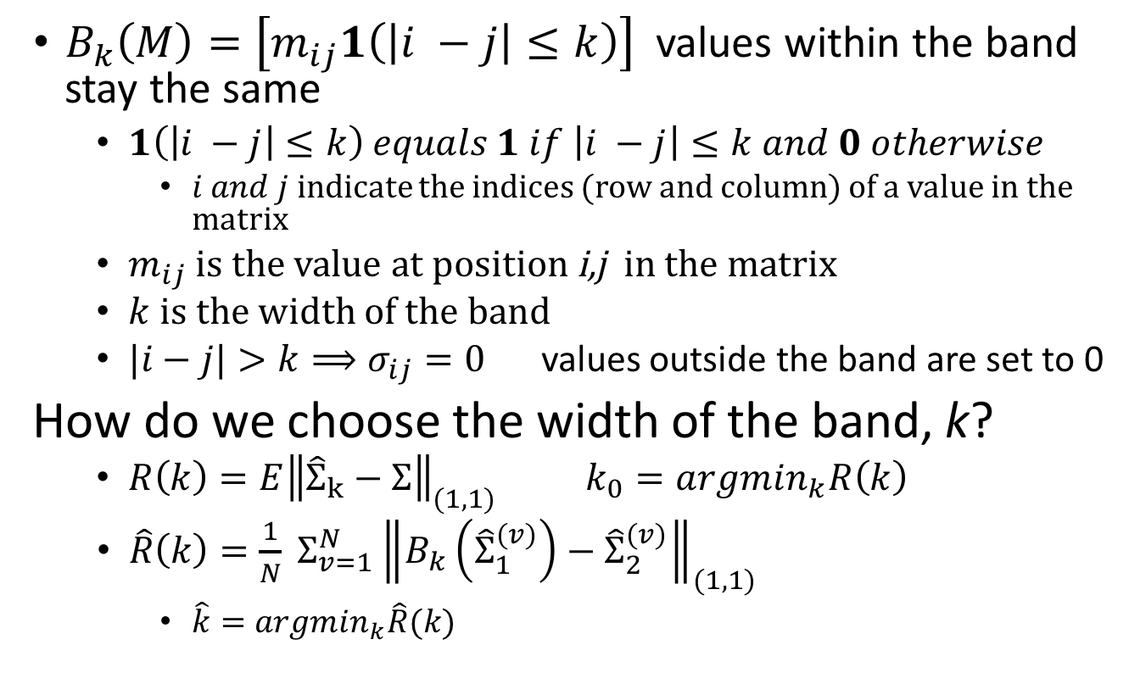
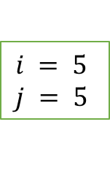

Banding Equations
$B_{k}\left(M\right)=\left[m_{ij}1\left(\left|i −j\right|≤k\right)\right]$ values within the band stay the same
$1\left(\left|i −j\right|≤k\right) equals 1 if \left|i −j\right|≤k and 0 otherwise$
$i and j$ indicate the indices (row and column) of a value in the matrix
$m_{ij}$ is the value at position i,j in the matrix
$k$ is the width of the band
$|i−j|>k⟹σ_{ij}=0$ values outside the band are set to 0
How do we choose the width of the band, k?
$R\left(k\right)=E{\left\|{\hat{Σ}}_{k}−Σ\right\|}_{(1,1)}$ $k_{0}=argmin_{k}R\left(k\right)$
$\hat{R}\left(k\right)=\frac{1}{N} Σ_{v=1}^{N}{\left\|B_{k}\left({\hat{Σ}}_{1}^{\left(v\right)}\right)−{\hat{Σ}}_{2}^{\left(v\right)}\right\|}_{(1,1)}$
$\hat{k}=argmin_{k}\hat{R}(k)$
$$k$$
$$i = 5$$
$$j = 5$$

Slide 24
Tapering

Slide 25
Tapering Intuition
Tapering is similar to banding. In banding, values are set to 0. In tapering, they approach 0
Tapering and Banding can be used in similar contexts, but tapering tends to give better results
Instead of setting values to 0 outside a band (as in banding), we decrease values proportional to their distance from the diagonal.
Values in the corners will be close to 0, while values on the diagonal will not be changed.

Slide 26
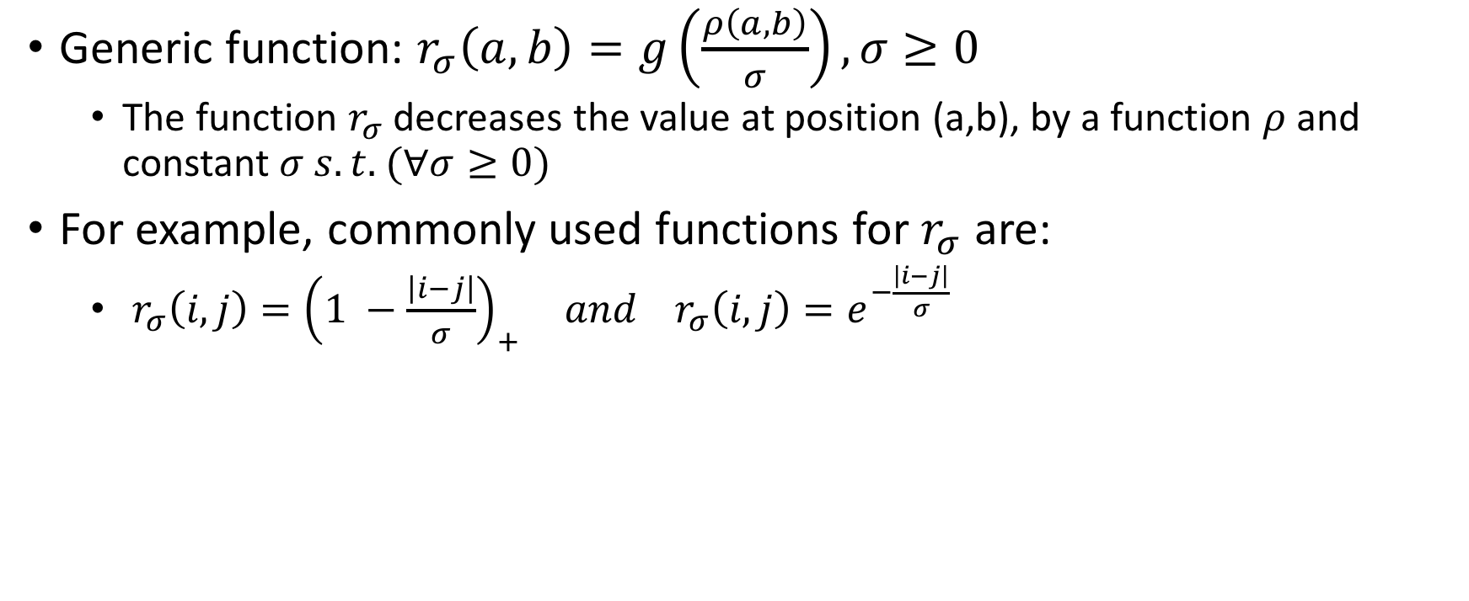
Tapering Equations
Generic function: $r_{σ}\left(a,b\right)=g\left(\frac{ρ\left(a,b\right)}{σ}\right), σ≥0$
The function $r_{σ}$ decreases the value at position (a,b), by a function $ρ$ and constant $σ s.t.$ $(∀σ≥0)$
For example, commonly used functions for $r_{σ}$ are:
$r_{σ}\left(i,j\right)={\left(1 −\frac{\left|i−j\right|}{σ}\right)}_{+} and r_{σ}\left(i,j\right)=e^{−\frac{\left|i−j\right|}{σ}}$
We recommend using this function
Thresholding

Slide 27
Thresholding

Slide 28
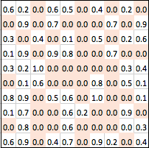
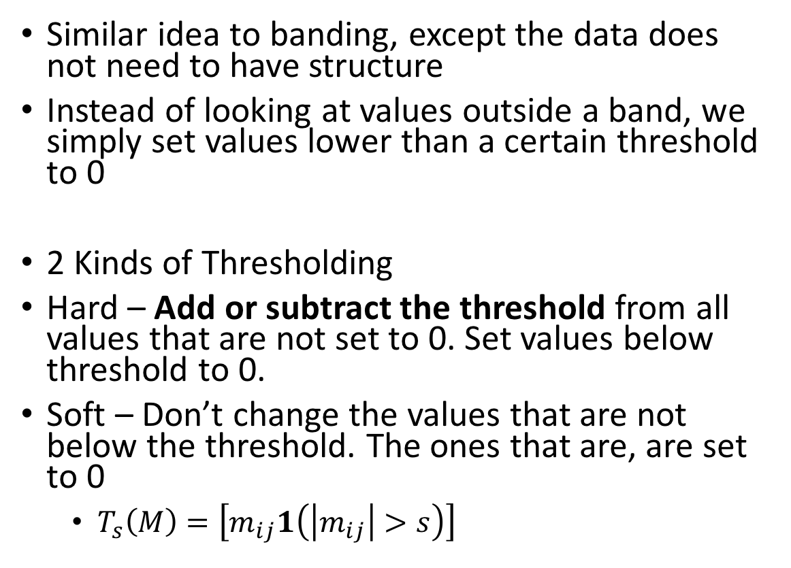
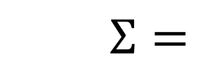
Thresholding Idea
Sparse covariance matrix
$$Σ=$$
Similar idea to banding, except the data does not need to have structure
Instead of looking at values outside a band, we simply set values lower than a certain threshold to 0
2 Kinds of Thresholding
Hard – Add or subtract the threshold from all values that are not set to 0. Set values below threshold to 0.
Soft – Don’t change the values that are not below the threshold. The ones that are, are set to 0
$T_{s}\left(M\right)=\left[m_{ij}1\left(\left|m_{ij}\right|>s\right)\right]$

Slide 29
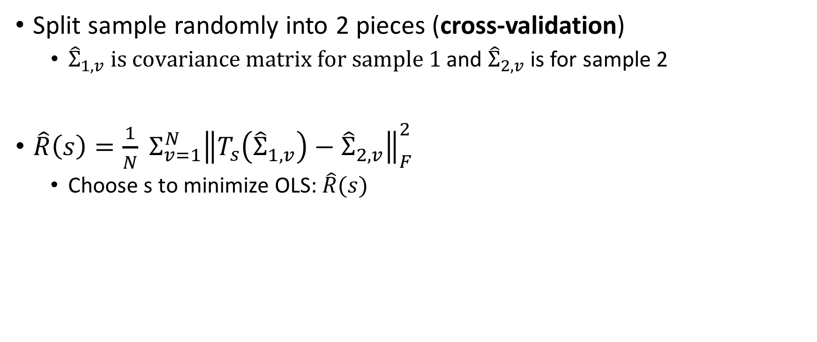
Selecting the Threshold
Split sample randomly into 2 pieces (cross-validation)
${\hat{Σ}}_{1,v} is covariance matrix for sample 1$ and ${\hat{Σ}}_{2,v}$ is for sample 2
$\hat{R}\left(s\right)=\frac{1}{N} Σ_{v=1}^{N}{\left\|T_{s}\left({\hat{Σ}}_{1,v}^{}\right)−{\hat{Σ}}_{2,v}^{}\right\|}_{F}^{2}$
Choose s to minimize OLS: $\hat{R}(s)$

Slide 30
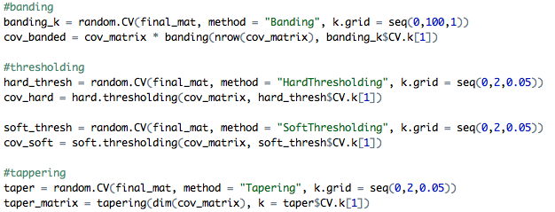
Banding, Tapering, Thresholding Code
Correlation Matrix without thresholding
Correlation Matrix with thresholding of 0.15

Slide 31
Couture Plots of Principal Components with soft thresholding
1st Principal Component
2nd Principal Component
3rd Principal Component
4th Principal Component

Slide 32
POET – Principal Orthogonal Complement Thresholding

Slide 33
Motivation
If the sample data is sparse or has more parameters than observations, need to estimate covariance matrix
POET provides a more sophisticated and effective way of estimating the covariance matrix than banding, thresholding, or tapering
For our example, data is not sparse, but n = 50 and p = 250 so there is a dimensionality problem.
Therefore we will use POET to estimate covariance matrix

Slide 34
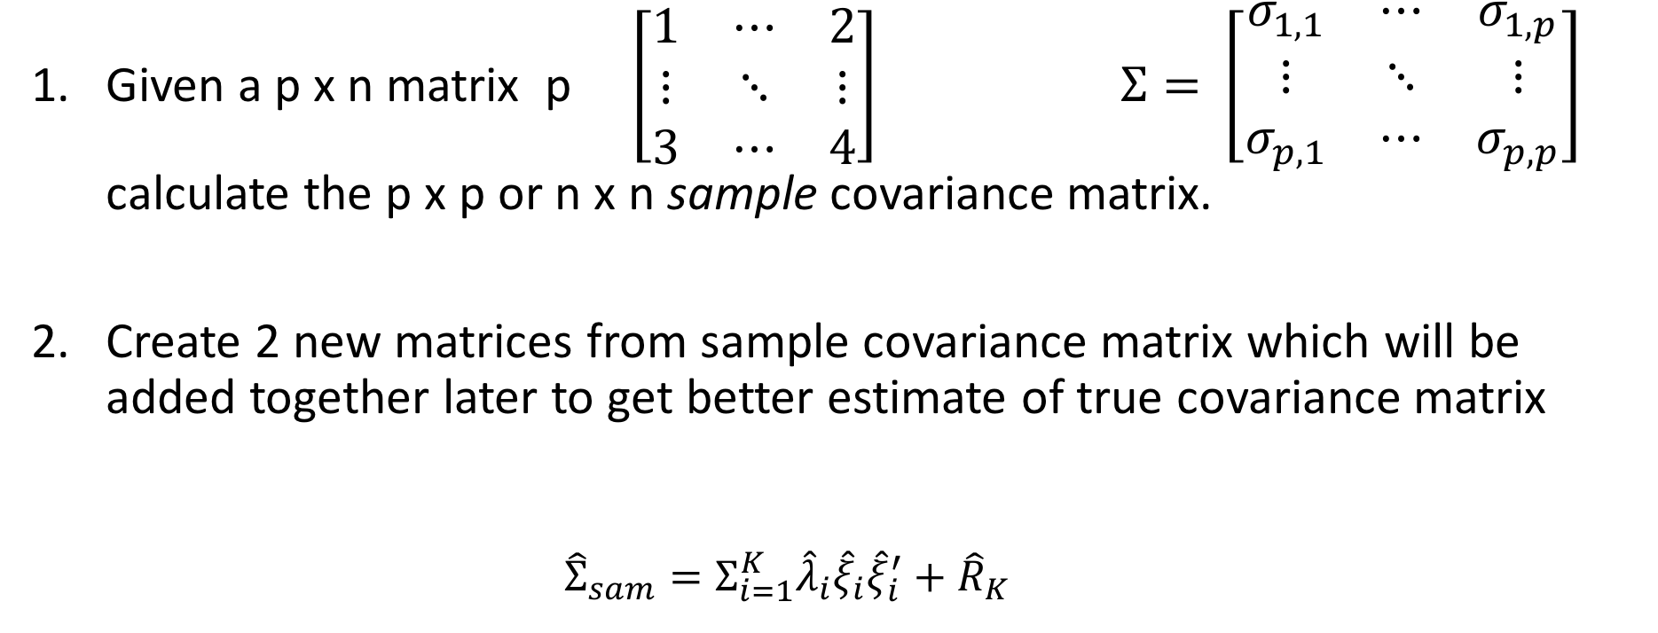
Overview
n
Given a p x n matrix p $\left[\begin{matrix}1 & ⋯ & 2 \\ ⋮ & ⋱ & ⋮ \\ 3 & ⋯ & 4\end{matrix}\right]$ $Σ=$ $\left[\begin{matrix}σ_{1,1} & ⋯ & σ_{1,p} \\ ⋮ & ⋱ & ⋮ \\ σ_{p,1} & ⋯ & σ_{p,p}\end{matrix}\right]$ calculate the p x p or n x n sample covariance matrix.
Create 2 new matrices from sample covariance matrix which will be added together later to get better estimate of true covariance matrix
${\hat{Σ}}_{sam}=Σ_{i=1}^{K}{\hat{λ}}_{i}{\hat{ξ}}_{i}{\hat{ξ}}_{i}^{′}+{\hat{R}}_{K}$
Eigenvalue
Eigenvector of sample covariance matrix
Matrix 1: PCA
Matrix 2: Thresholding

Slide 35
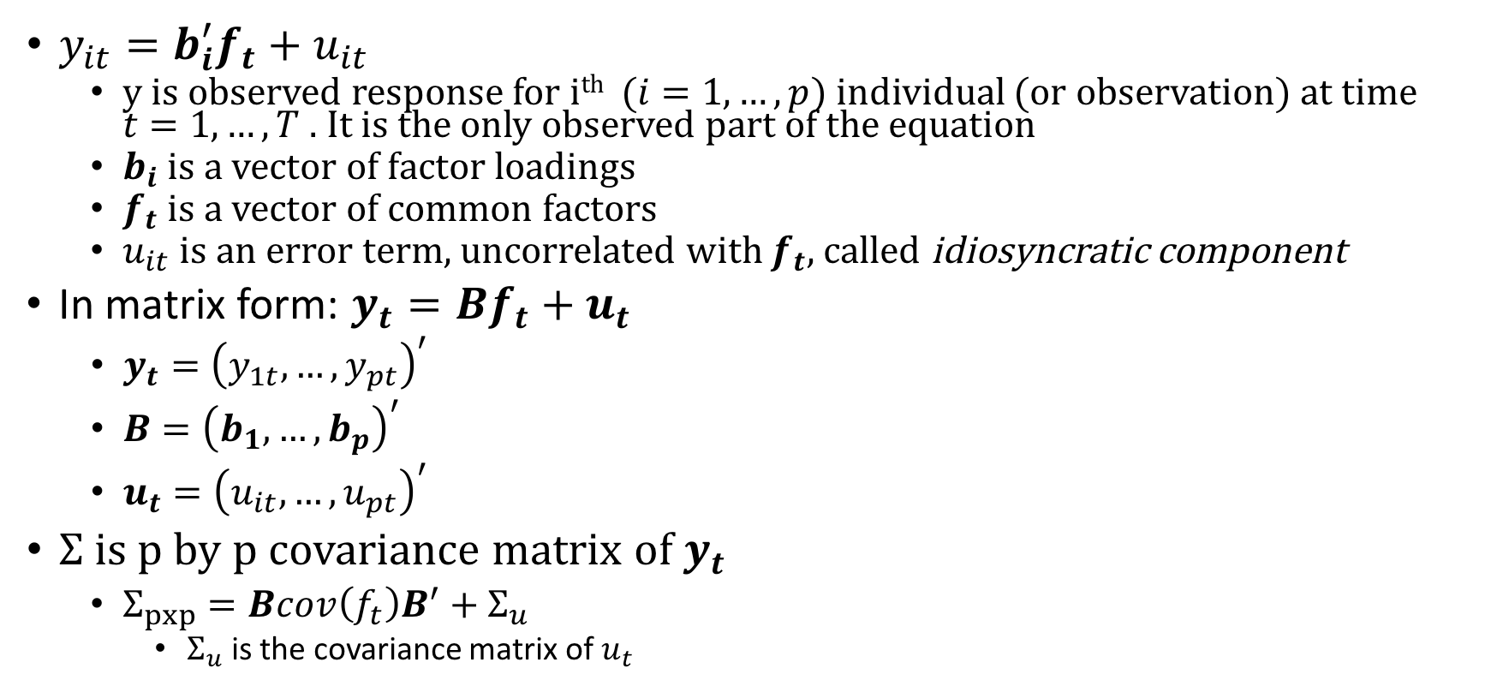
Factor Model
$y_{it}=b_{i}^{′}f_{t}+u_{it}$
y is observed response for i^{th} ($i=1,…,p)$individual (or observation) at time $t=1, …, T$ . It is the only observed part of the equation
$b_{i}$ is a vector of factor loadings
$f_{t}$ is a vector of common factors
$u_{it}$ is an error term, uncorrelated with $f_{t},$ called idiosyncratic component
In matrix form: $y_{t}=Bf_{t}+u_{t}$
$y_{t}={\left(y_{1t}, …, y_{pt}\right)}^{′}$
$B={\left(b_{1}, …, b_{p}\right)}^{′}$
$u_{t}={\left(u_{it},…, u_{pt}\right)}^{′}$
$Σ$ is p by p covariance matrix of $y_{t}$
$Σ_{pxp}=Bcov\left(f_{t}\right)B^{′}+Σ_{u}$
$Σ_{u}$ is the covariance matrix of $u_{t}$

Slide 36
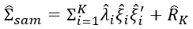
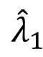
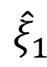

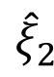
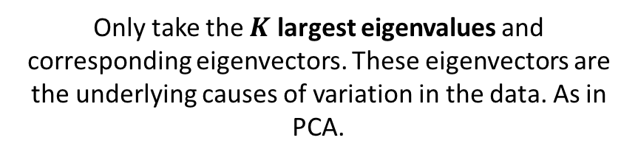
Matrix 1 – PCA on sample covariance matrix
Only take the $K$ largest eigenvalues and corresponding eigenvectors. These eigenvectors are the underlying causes of variation in the data. As in PCA.
Eigenvalues
$$Σ_{i=1}^{K}{\hat{λ}}_{i}{\hat{ξ}}_{i}{\hat{ξ}}_{i}^{′}$$
Eigenvectors
The idea here is to find the fundamental, underlying factors in the sample covariance matrix and include them in our estimate of the ‘true’ covariance matrix
$${\hat{ξ}}_{2}$$
$${\hat{ξ}}_{1}$$
Eigendecomposition on the sample covariance
$${\hat{λ}}_{1}$$

Slide 37
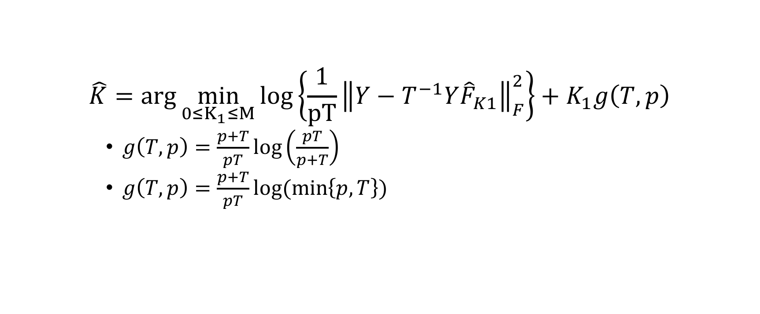
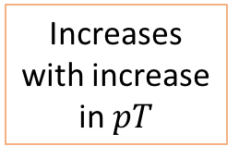
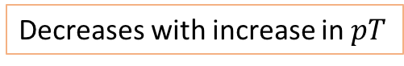
Choosing the number of factors ~ K
Increases with increase in $pT$
Decreases with increase in $pT$
$$\hat{K}=\arg{\min_{0≤K_{1}≤M}{\log\left\{\frac{1}{pT}{\left\|Y−T^{−1}Y{\hat{F}}_{K1}\right\|}_{F}^{2}\right\}}+K_{1}g\left(T,p\right)}$$
$g\left(T,p\right)=\frac{p+T}{pT}\log\left(\frac{pT}{p+T}\right)$
$g\left(T,p\right)=\frac{p+T}{pT}log⁡(\min\left\{p,T\right\})$
These are modified functions of BIC and AIC. Can choose either one
This method was first introduced in Bai and NG (2002)

Slide 38
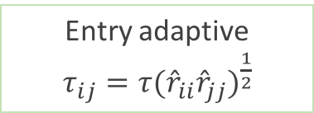
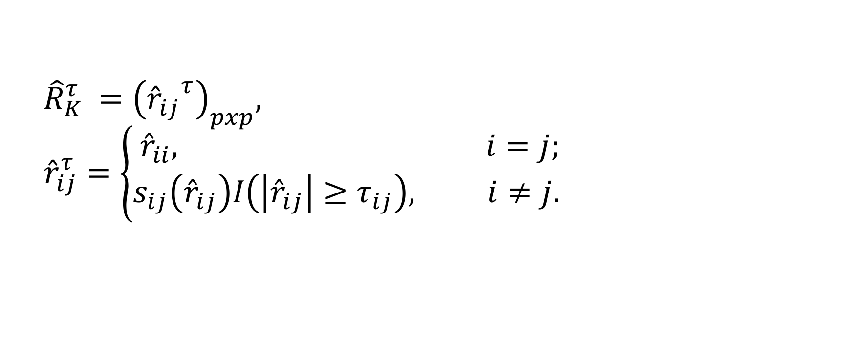
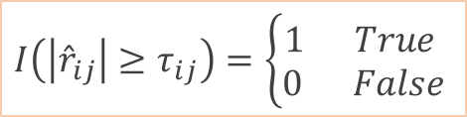
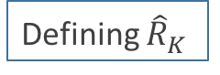
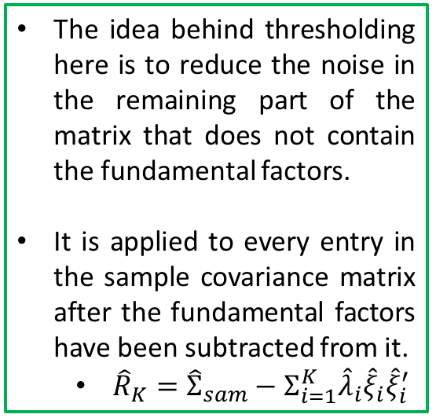
Matrix 2 – Thresholding
$${\hat{R}}_{K}^{τ }={\left({{\hat{r}}_{ij}}^{τ}\right)}_{pxp}, {\hat{r}}_{ij}^{τ}=\left\{\begin{aligned}{\hat{r}}_{ii}, i=j; \\ s_{ij}\left({\hat{r}}_{ij}\right)I\left(\left|{\hat{r}}_{ij}\right|≥τ_{ij}\right), i≠j. \end{aligned}\right.$$
The idea behind thresholding here is to reduce the noise in the remaining part of the matrix that does not contain the fundamental factors.
It is applied to every entry in the sample covariance matrix after the fundamental factors have been subtracted from it.
${\hat{R}}_{K}={\hat{Σ}}_{sam}−Σ_{i=1}^{K}{\hat{λ}}_{i}{\hat{ξ}}_{i}{\hat{ξ}}_{i}^{′}$
Defining ${\hat{R}}_{K}^{}$
Don’t change diagonal
Shrinkage function for soft thresholding. For hard thresholding, simply remove
$$I\left(\left|{\hat{r}}_{ij}\right|≥τ_{ij}\right)=\left\{\begin{aligned}1 True \\ 0 False\end{aligned}\right.$$
Entry adaptive
$τ_{ij}=τ{({\hat{r}}_{ii}{\hat{r}}_{jj})}^{\frac{1}{2}}$

Slide 39
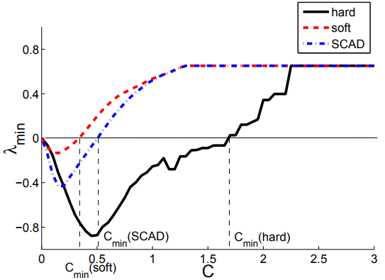
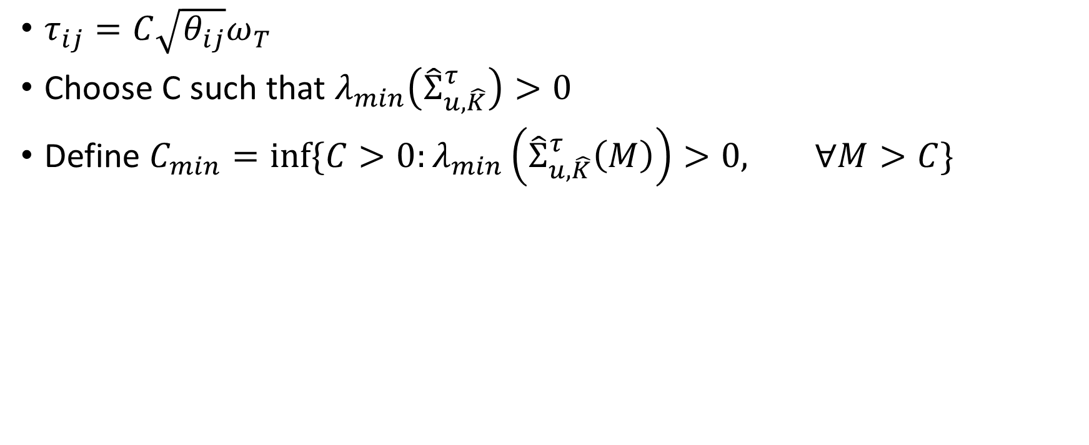

Choosing the threshold ~ $τ$dependent on C
$τ_{ij}=C\sqrt{θ_{ij}}ω_{T}$
Choose C such that $λ_{min}\left({\hat{Σ}}_{u,\hat{K}}^{τ}\right)>0$
Define $C_{min}=inf⁡\{C>0:λ_{min}\left({\hat{Σ}}_{u,\hat{K}}^{τ}\left(M\right)\right)>0, ∀M>C\}$
Find the smallest C such that the matrix is positive definite

Slide 40
POET Examples

Slide 41

Markowitz (1952, 1959)
Markowitz is a major theory in financial analysis.
Purpose is to minimize the risk of a portfolio by shifting the amount you invest in (weight of) each stock, given an expected (fixed) return
For reference
$μ=E\left[daily portfolio return\right]$
$μ^{∗}=Desired daily return (higher means more risk)$
$Σ=cov\left(daily portfolio return\right)$
$w=vector containing stock weights in the portfolio$
Goal: $w_{eff}=\arg{\min_{w}{w^{T}Σw subject to w^{T}μ=μ^{∗}, w^{T}1=1}}$
$w_{eff}=\left\{BΣ^{−1}1−AΣ^{−1}μ+μ^{∗}\left(CΣ^{−1}μ−AΣ^{−1}1\right)\right\}/D$
$A=μ^{T}Σ^{−1}1$
$B=μ^{T}Σ^{−1}μ$
$C=1^{T}Σ^{−1}1$
$D=BC−A^{2}$
Self selected

Slide 42

Stock Market Data
50 stocks, 10 from each sector (consumer goods, credit services, hospitals, consumer services like restaurants and hotels, and utilities)
Recorded daily prices over a 1 year period (252 days)
Data organized such that rows are grouped by industry
For example, the first 10 rows are all stocks of companies in the consumer goods industry

Slide 43





Code for POET estimator

Slide 44


Markowitz Code

Slide 45

Result
Conclusion: The risk of the covariance matrix estimated by POET is less than half (approximately 15% less) than the risk calculated using diagonal matrix

Slide 46
Result
Distribution of Portfolio Weights without POET
Distribution of Portfolio Weights with POET
Conclusion: When calculating portfolio weights without POET, we find all weights to be within narrow range and one stock having a marginally higher weight.
When we use POET to estimate, our results improve. We have a wider range of portfolio weights, with the top stocks getting very high weightage. We also consider for short selling (negative weight) poorly performing stocks.

